Slide 1
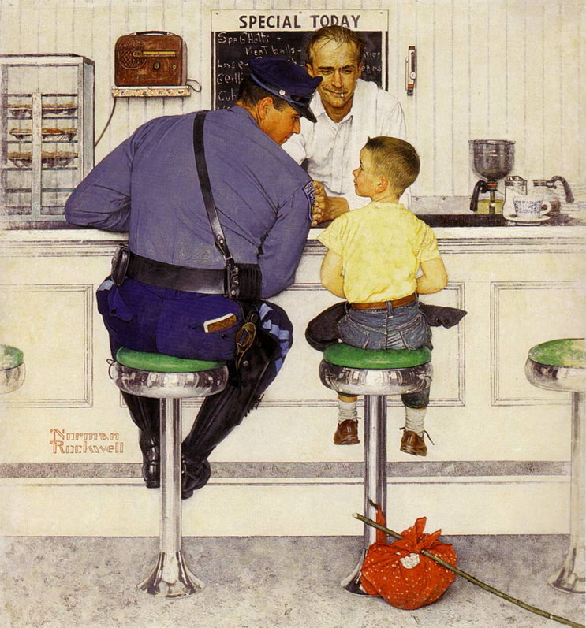
Norman Rockwell, “Runaway”

Slide 2
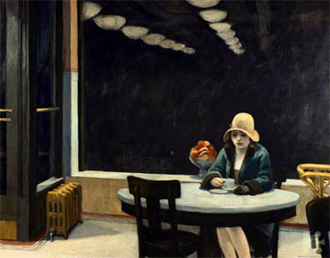
Edward Hopper, “The Automat”

Slide 3
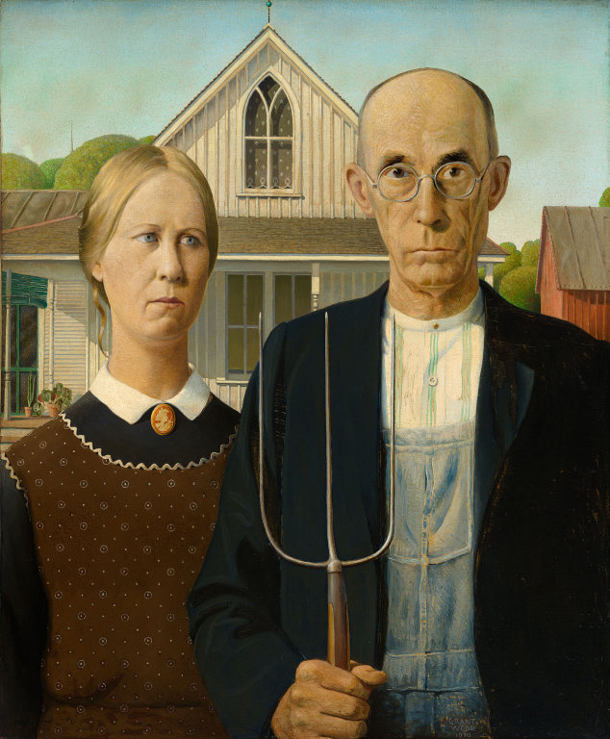
Grant Wood, “American Gothic?

Slide 4
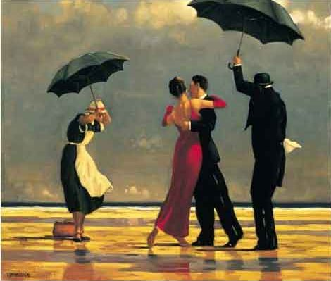
Jack Vetrianno, “The Singing Butler”

