Slide 2
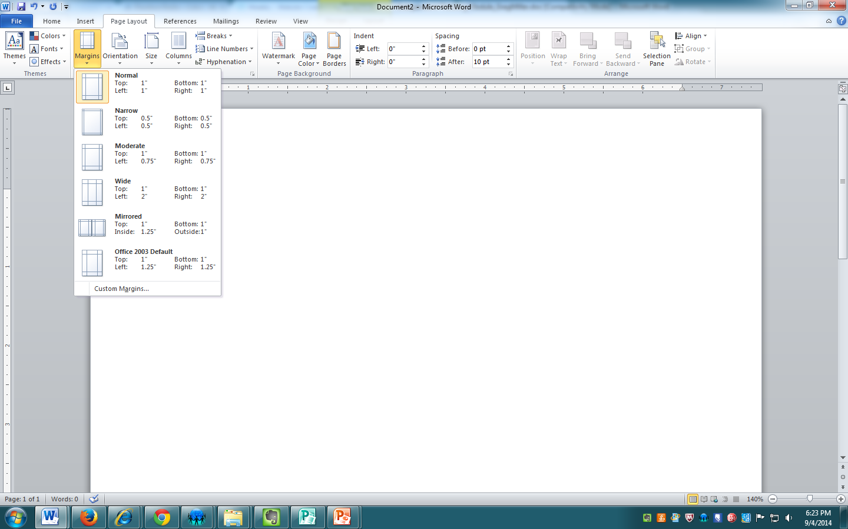
Margins
In a New page, go to Page Layout, Margins, Normal (for 1” margins)
I already set the font to Times New Roman, 12 point in Home.

Slide 3
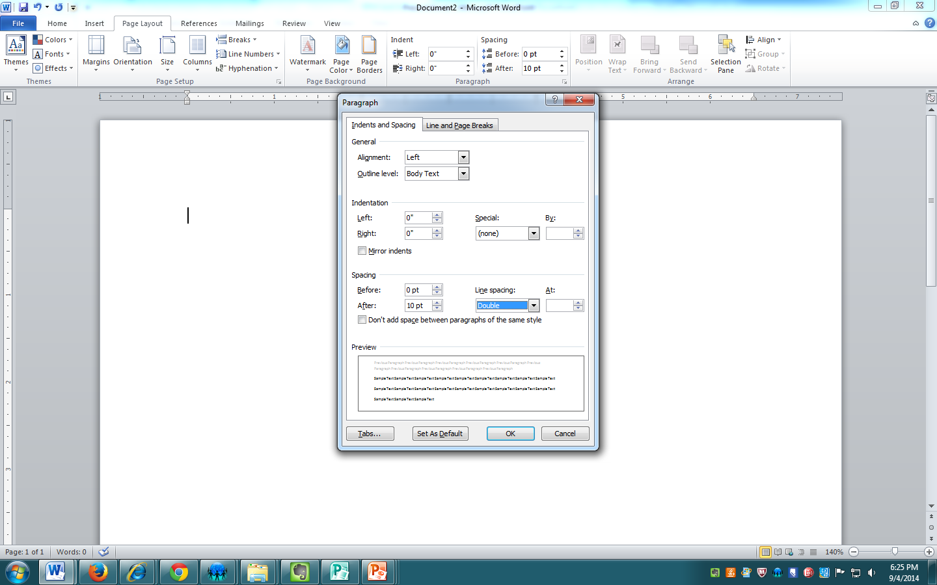
Line Spacing
Go to Paragraph (click in the lower right on the arrow); set the line spacing to double.

Slide 4
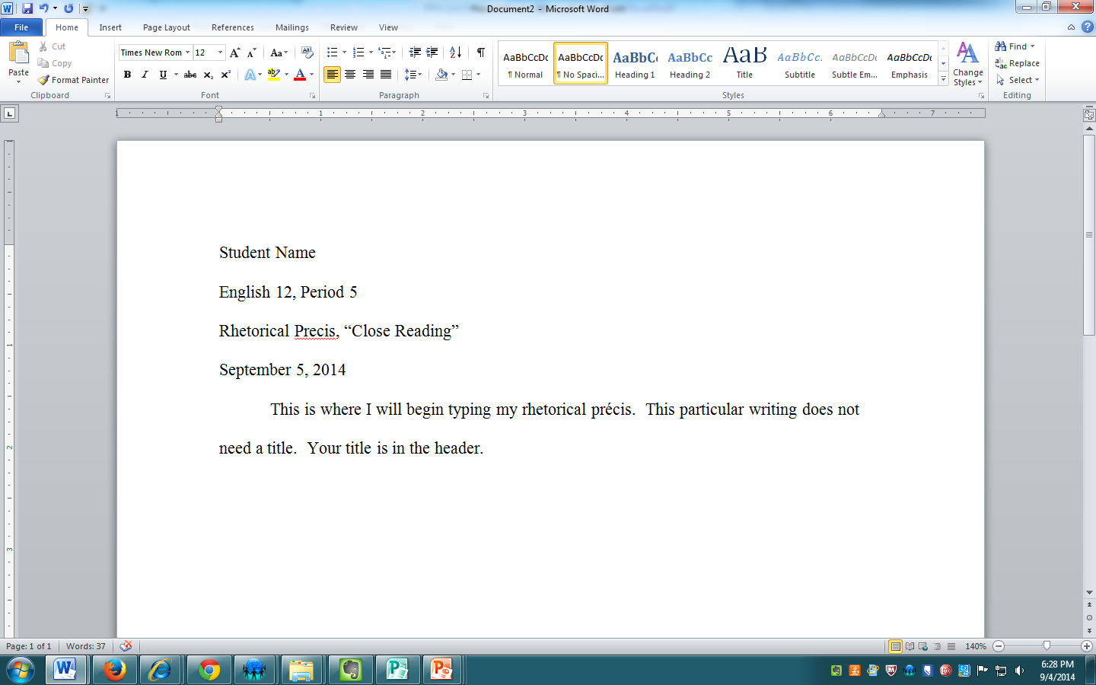
Header & Text

Slide 5
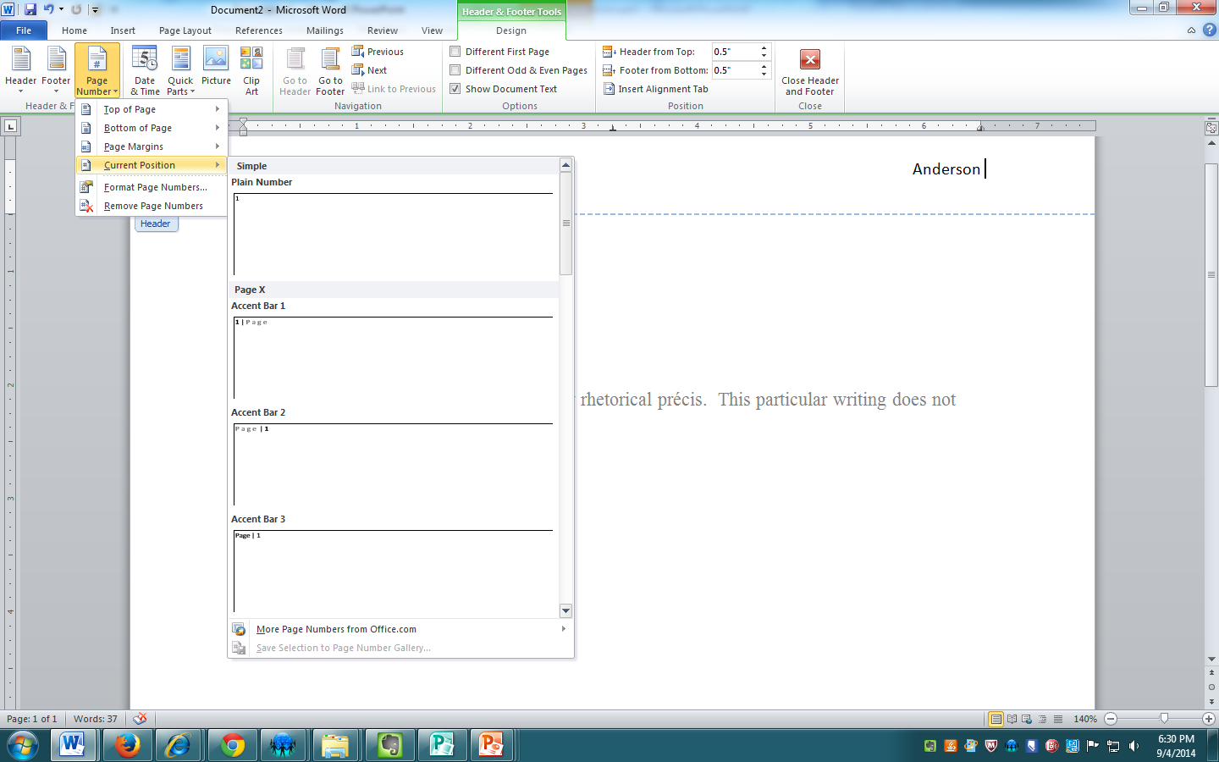
Internal Header (Usually for papers of more than 1 page)
Double-click at the top of your paper. This accesses the header (the bottom accesses the
Footer. Tab the cursor to the right. Type your last name and one space. Click on Page #,
Current Position, and Plain Number.

Slide 6
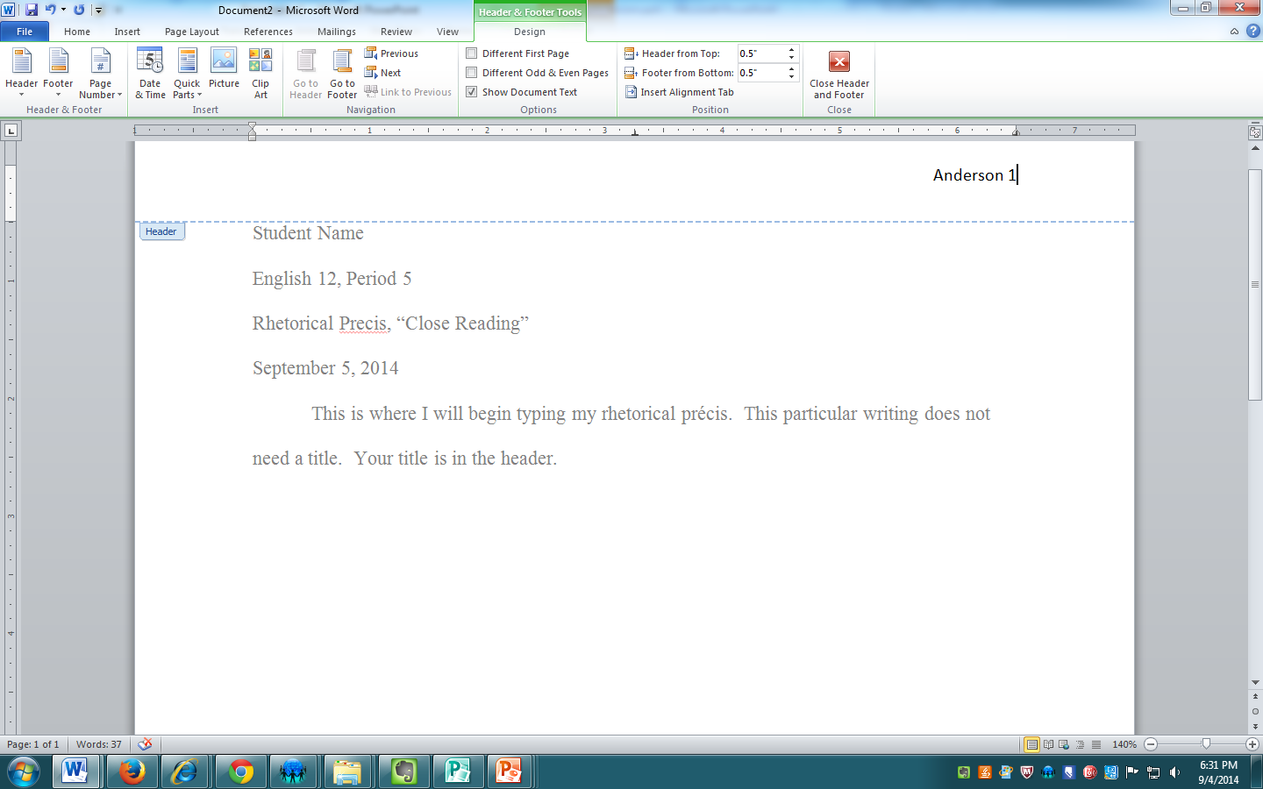
Looks like This! Ta Da

